Slide 1
Plot Elements using LLMs and LangChain
Ryan Peruski, Nolan Coffey, Triton Eden, William Duff
Notes:
Will

Slide 2
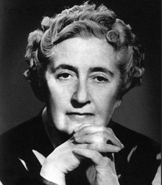
The Assignment
Team 5:
Develop a LangChain-based reasoning system that can interpret your author’s novels and the plots
Our focus:
Take our plot points and pre-processing techniques and apply them to an LLM using LangChain’s Retrieval Augmented Generation tool -> The LLM will tell us the novel’s plot points.
Notes:
Will

Slide 3
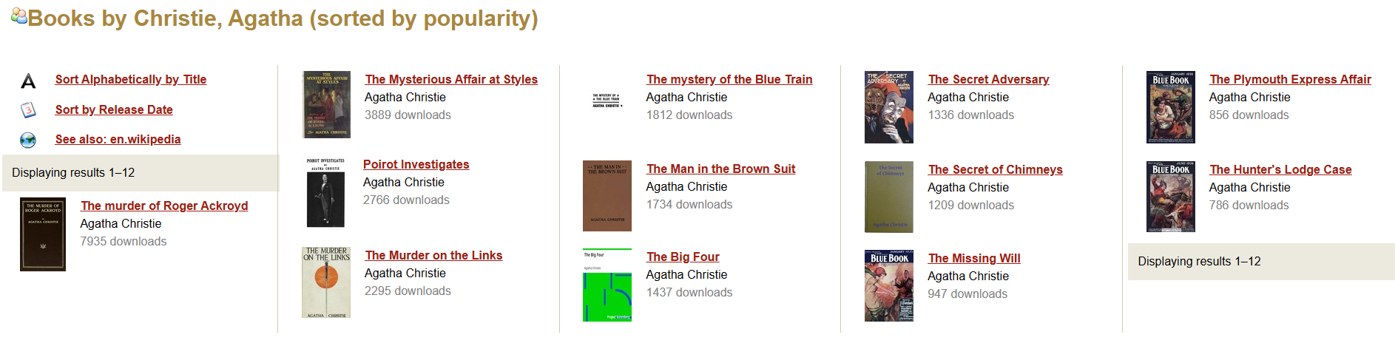
Data Extraction
Used Project Gutenberg to get the Agatha Christie books
We analyzed 3 books that seemed similar (same protagonist, same kind of plot, etc)
After that, we manually grabbed key points (protagonist, victim, antagonist, murder weapon, AND the chapter in which the antagonist is revealed, or climax chapter)
Notes:
Go over this quickly, as it’s the same as project 1 - Peruski

Slide 4
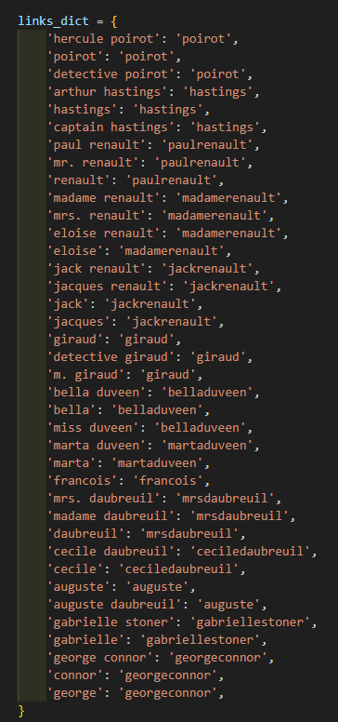
Preprocessing NLTK → spaCy
Turns raw txt file with book into tokens we can use for the model
We normalize, tokenize, and clean – as per usual in NLP
Our Independent Variable -> Coreference Resolution (added or not added)
Expanded our Multi Word Expressions from Project 1 to include all characters (used multiple wikis for this information).
Notes:
Explain coreference resolution and how that will be useful - Nolan

Slide 5
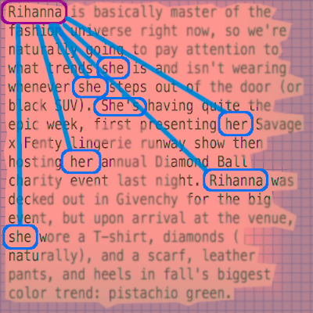
Coreference Resolution:
John went home, then he went to bed.
John went home, then John went to bed.
spaCy’s Coreferee Library
Notes:
Nolan

Slide 6
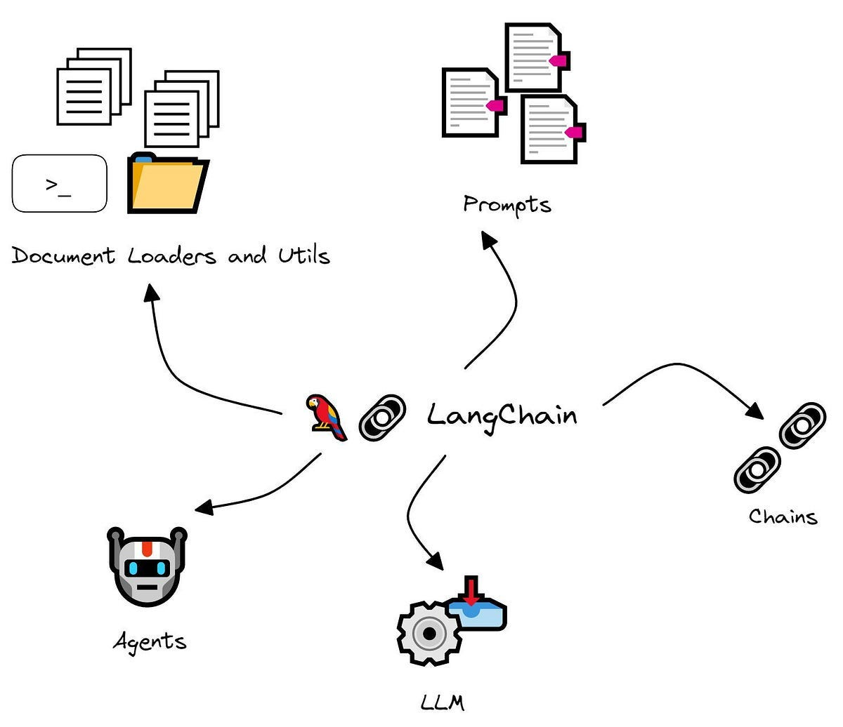
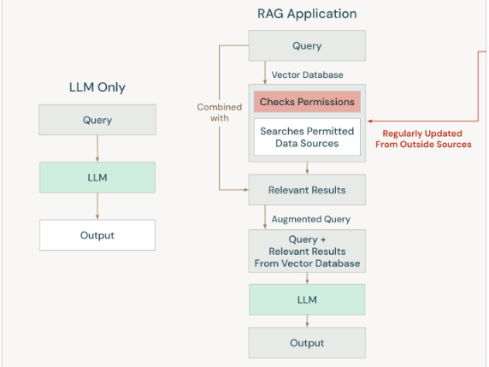
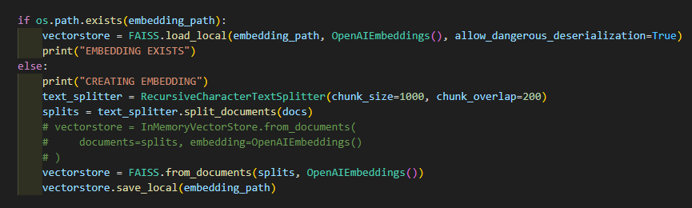
Methods, Code, and Libraries
Used LangChain library to incorporate Retrieval Augmented Generation (RAG) and inputting the preprocessed novels into the LLM.
For simplicity, we used OpenAI’s GPT 4o-mini model via. LangChain
Switched to spaCy pipeline for tokenization and coreference resolution
FAISS (with euclidean distance) used to retrieve context
Notes:
Peruski PERUSKI
Explain what RAG is in own words and own context -> figure is from Begoli’s notes

Slide 7
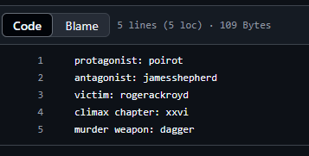
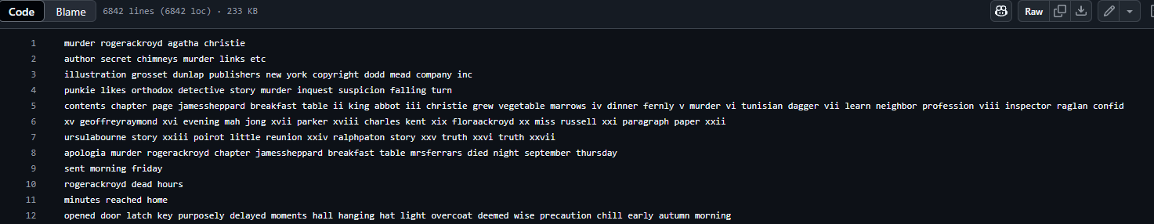
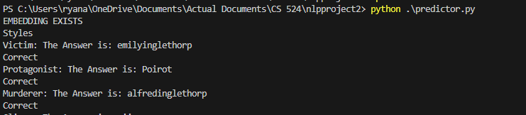
Methodology
Get the book
find important key points in book (manually) -> these are our “ground truths”
preprocess book
use LangChain’s RAG system on simple queries: “Who is the murderer”, “Who is the main protagonist”, etc.
Compare with ground truths for an accuracy score
Notes:
To be clear, the model is GIVEN the novel and a query - Peruski

Slide 8
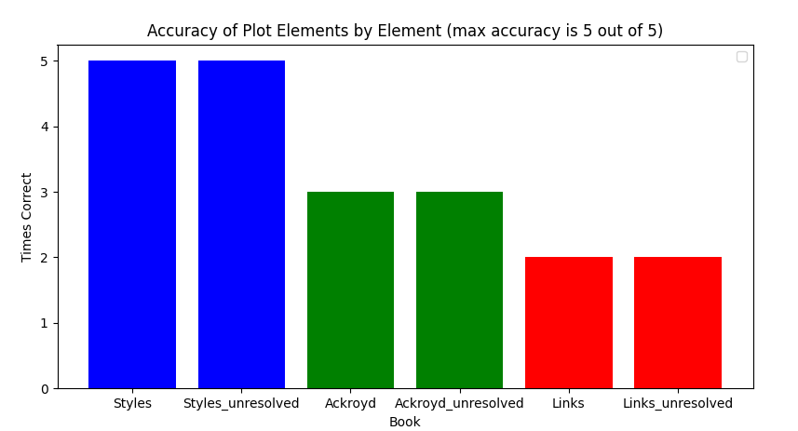
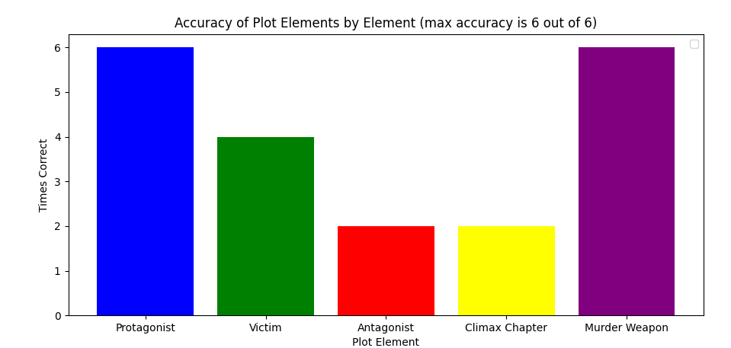
Results
There was little to no difference when adding coreference resolution to the preprocessing phase
The predictor predicts the protagonist, victims, and murder weapons well, but not so much the climax chapters. This may be because when the climax occurs can be debatable.
Notes:
Triton

Slide 9
Results: Coreference Resolution == Unresolved Text
Book | Protagonist | Victim | Antagonist | Climax Chapter | Murder Weapon | Total Correct
Styles | Correct | Correct | Correct | Correct | Correct | 5/5
Ackroyd | Correct | Correct | X | X | Correct | 3/5
Links | Correct | X | X | X | Correct | 2/5
Notes:
Self-Attention can process enough context and create flexible mappings without explicit coreference resolution.

Slide 10
Long Response:
"Who is the victim of this novel, how were they killed, who killed them, and why did they do it?"
Styles:
The victim of the novel is Emily Inglethorp, who was killed by strychnine poisoning. The murderer is Alfred Inglethorp, who, along with Evelyn Howard, conspired to kill her to gain her money. Their motive was to induce the wealthy old lady to leave her money to them through a cleverly conceived crime.
Ackroyd:
The victim of the novel "The Murder of Roger Ackroyd" is Roger Ackroyd, who was killed with a dagger. The context does not provide enough information about who specifically killed him or the motive behind the murder.
Links:
The context does not provide enough information.

Slide 11
Long Response
Resolved vs. Unresolved, 5 trials:
"Who is the victim of this novel, how were they killed, who killed them, and why did they do it?"
Styles Resolved: Avg. 100% Accuracy
Styles Unresolved: 87.5% Accuracy - Missing Inheritance Motive
Ackroyd Resolved: Avg. 50% Accuracy - Missing killer, motive
Ackroyd Unresolved: Avg. 20% Accuracy - Missing weapon, killer, motive
Links Resolved: Avg. 0% Accuracy
Links Unresolved: Avg. 0% Accuracy

Slide 12
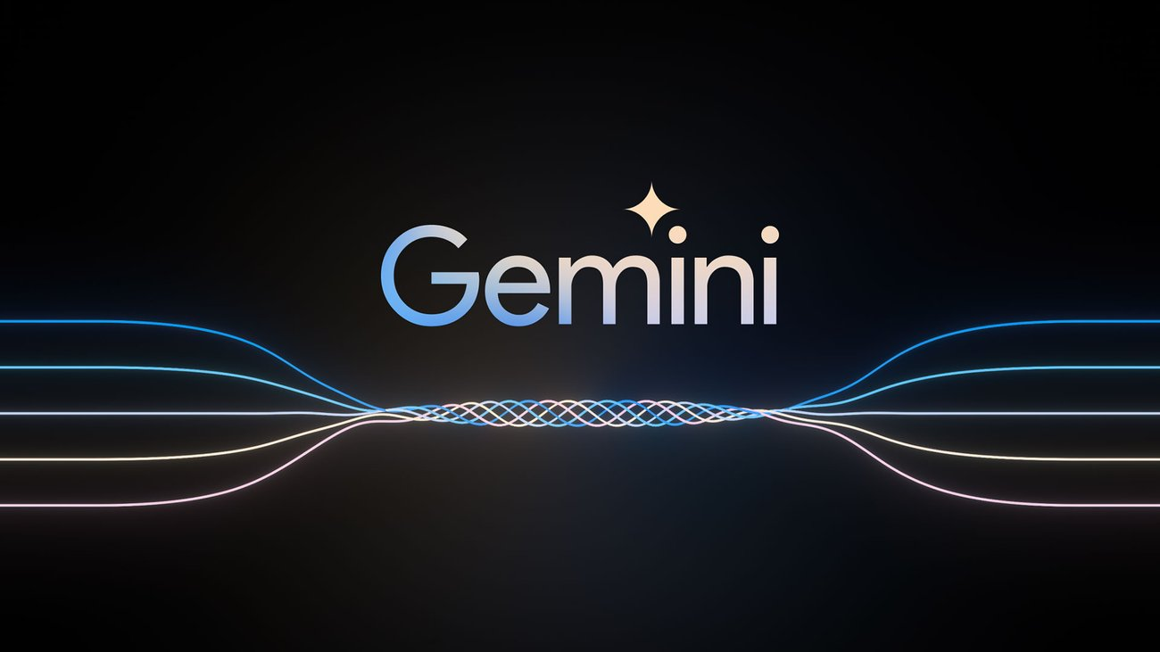

Future Prospects
Employ more intensive prompt engineering
Use different models with LangChain (LLaMA, Gemini, other OpenAI models like 4o (not mini)) or o1 preview
Compare with other novels than those of Agatha Christie’s work.
Look into more specific predictor metrics
How accurate can a predictor be if not given a list of characters and Multi Word Embeddings?
Notes:
Triton
We had strict time constraints when doing this experiment, so we kept things extremely simple. In short, there is so much more to do

Slide 13

Questions?

